Slide 1

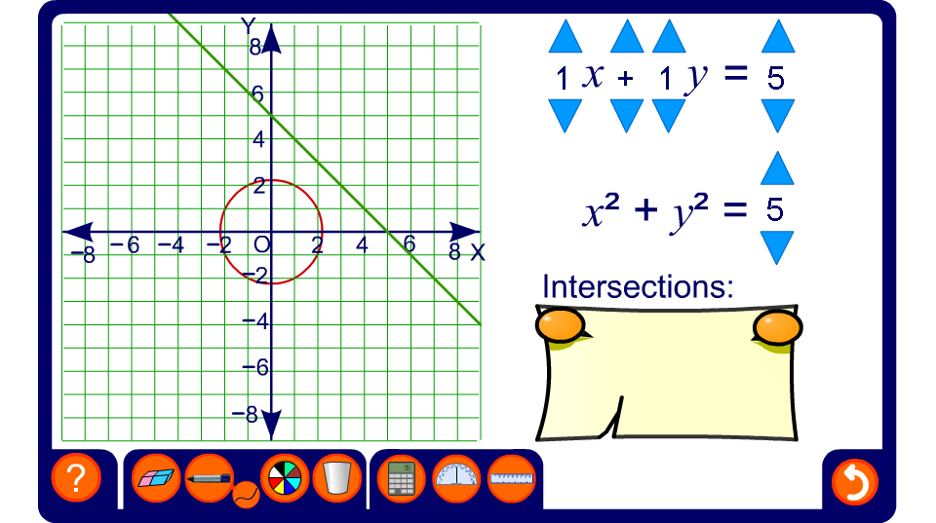


Linear and circular graphs
Notes:
Use this activity to demonstrate solutions to simultaneous equations where one equation is linear and the other is in the form x² + y² = r².
Start by demonstrating the solution to the example that was given in the previous slide:
y - x = 1
x² + y² = 13
Establish, however, that most solutions do not involve whole numbers. Conclude that the graph is a good way of visualizing the solutions but that an algebraic method will give more exact answers.
Investigate examples where there is only one pair of solutions (the line will be a tangent to the circle) and where there are no solutions.

